Slide 1

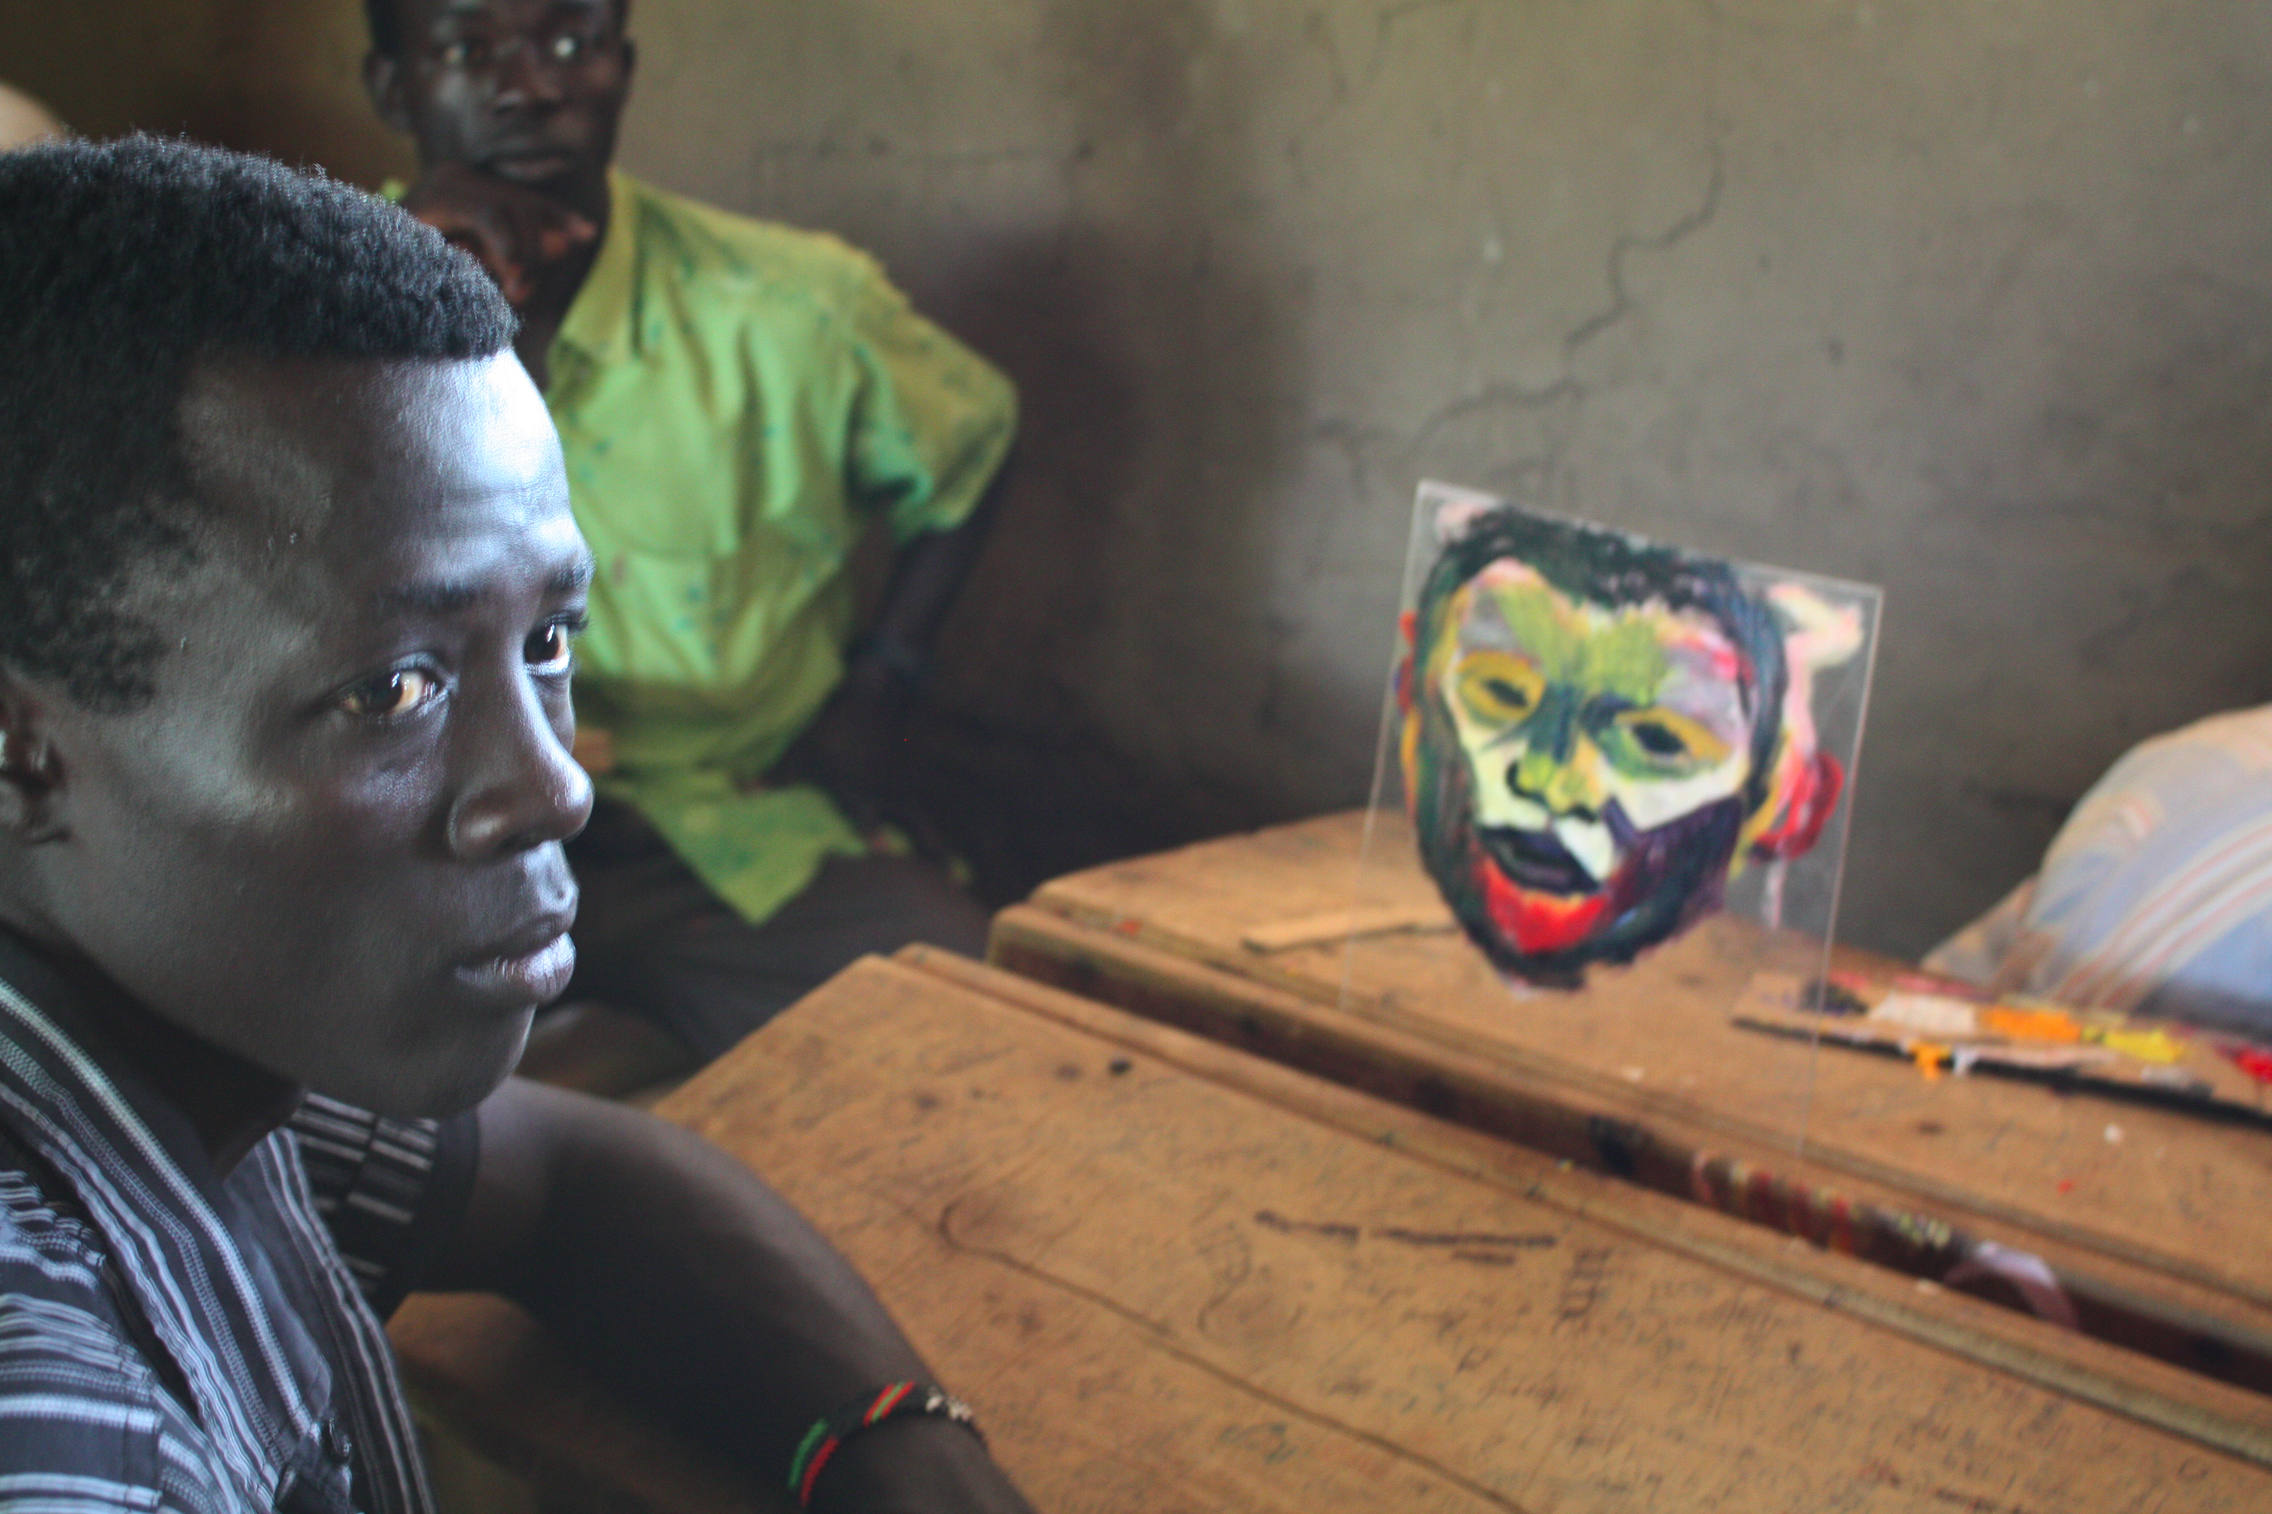
Sharing stories through Art
My Story • My Art • My Start

Slide 2
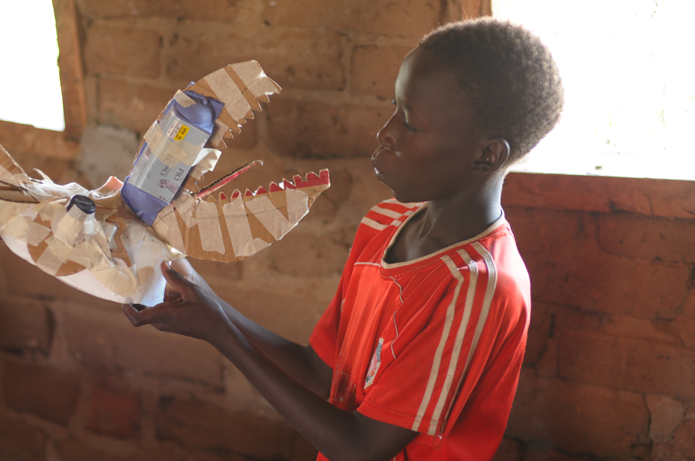
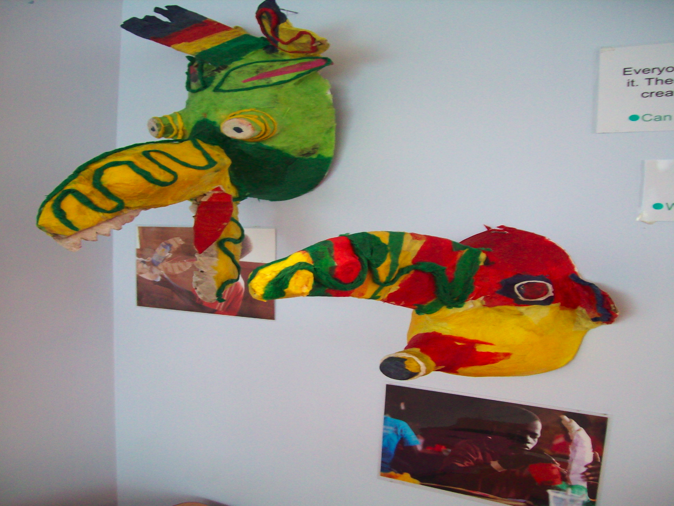
;Bug Workaround;
Who are we?
My start is a charity that facilitates art workshops for young people in Kakuma refugee camp; so they
can depict their lives and experiences.
ThWhhhpjpojr
The art work produced is then taken to the UK and exhibited in London schools so you can learn more about the issues raised in the work.

Slide 3
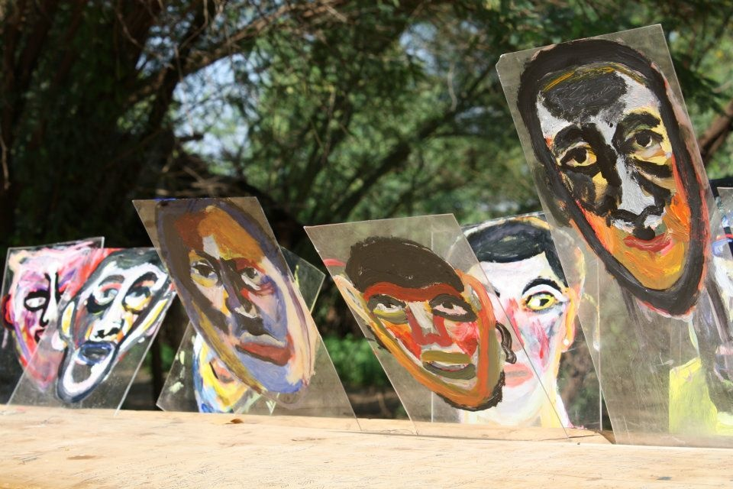

Why art in a refugee camp?
Notes:
Pose this question to your students- allow them to ponder on it as the presentation continues.

Slide 4
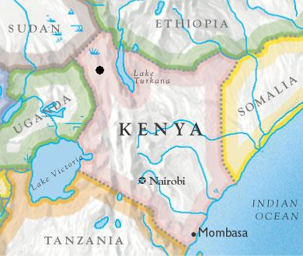
Where is Kakuma?
Notes:
In the North West point of Kenya.
On the border of Kenya and South Sudan.
Established in 1997 to accommodate thousands fleeing Sudan in Africa’s longest civil war.

Slide 5
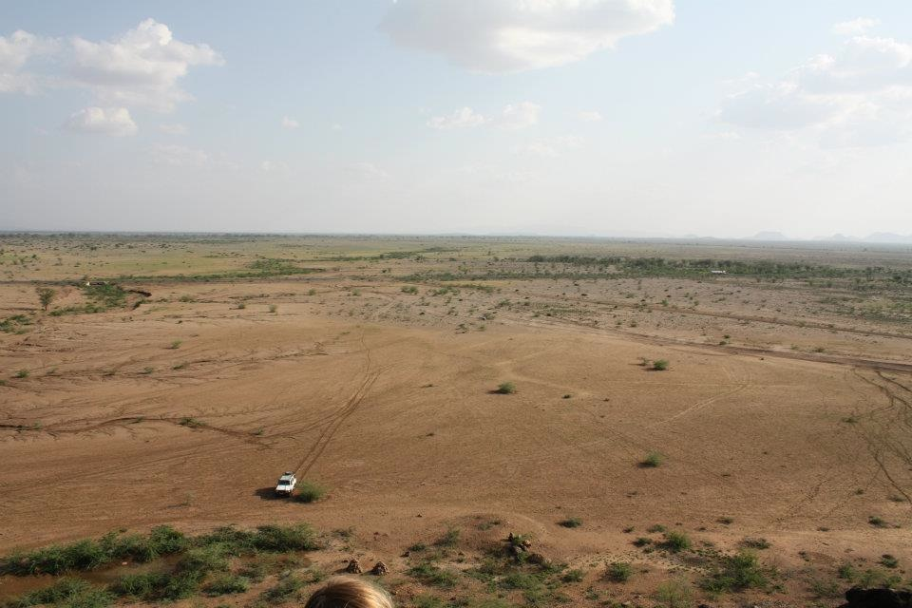
‘Nowhere’
Notes:
;Kakuma’ means nowhere
The refugee camp is in the middle of nowhere in Kenya-3 hours rocky road drive to the nearest town Lokichoggio
Average temperature 40 degrees.

Slide 6
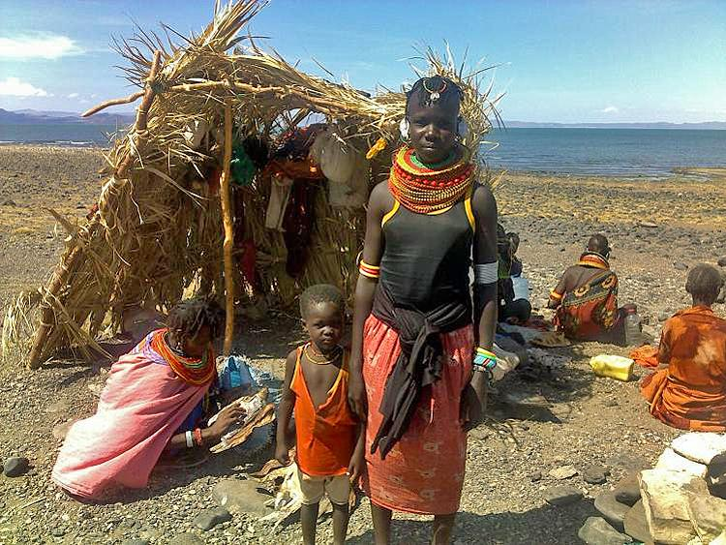
The Turkana Tribe
Notes:
Kakuma is in Turkana.
The Turkana tribe are the people that live there and are one of Kenya’s most ancient, primitive tribes.
They have been forced to share their land with the refugees. There are currently 187,000 refugees living in Kakuma.

Slide 7
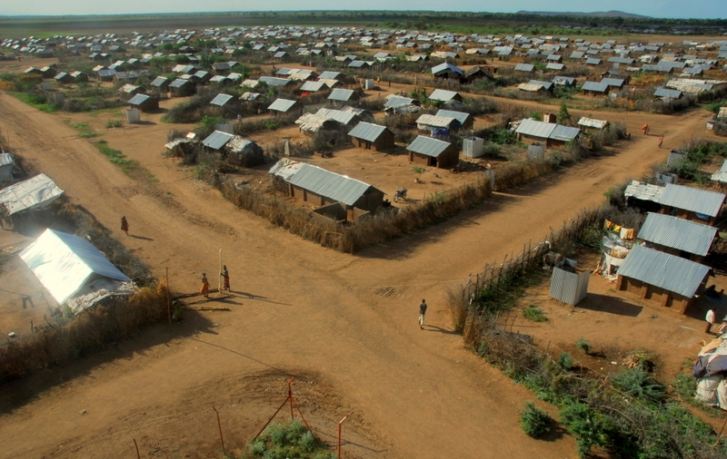
Notes:
Kakuma is comprised of 4 big zones. Each zone is separated into different ethnic and tribal communities. This has been done to avoid conflict and encourage a feeling of ‘home’-however as a result young people growing up in the camp live segregated now knowing the other types of people living alongside them. This can create distrust and suspicion. My Start projects in the camp are inclusive: we have a diverse selection of students from a number of different backgrounds within our groups. Why do you think this is important?

Slide 8
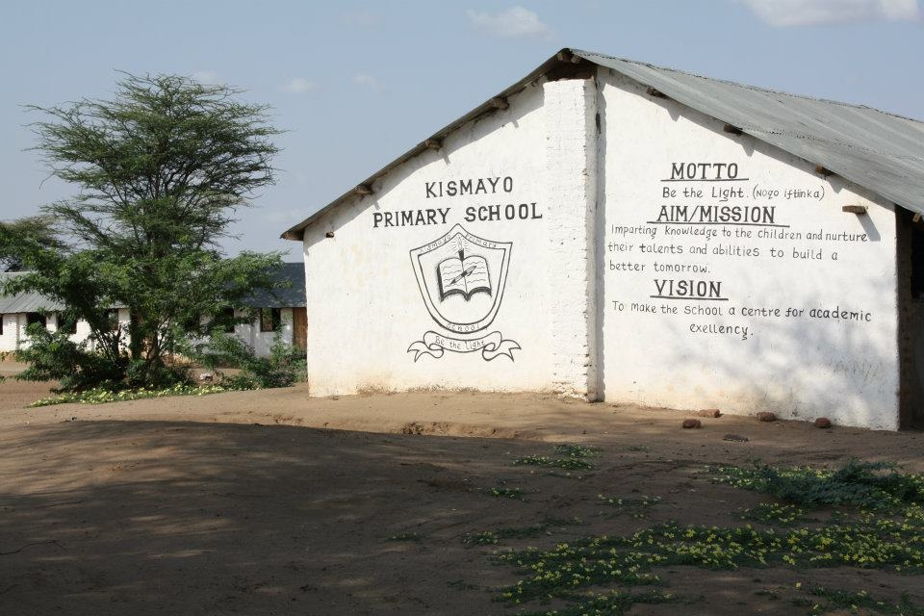
Notes:
The camp is well established and has set up a number of resources.
There are basic schools, hospitals and shops.
Some people were born in the camp and have lived there all their lives.

Slide 9
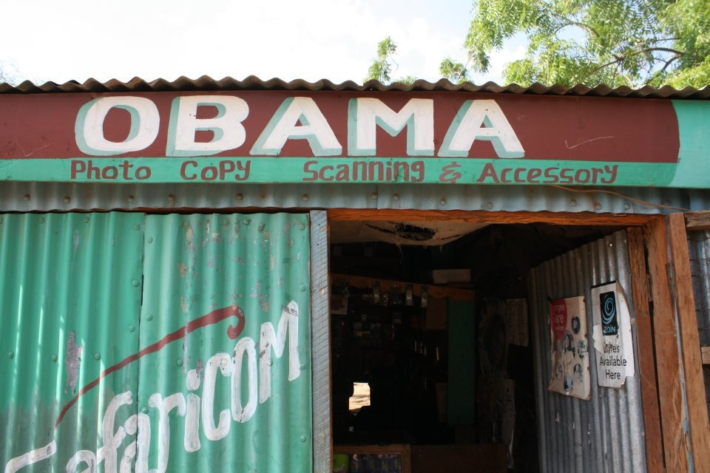
Notes:
This is a shop in the market place in Kakuma 1: one of the most developed areas of the camp.

Slide 10
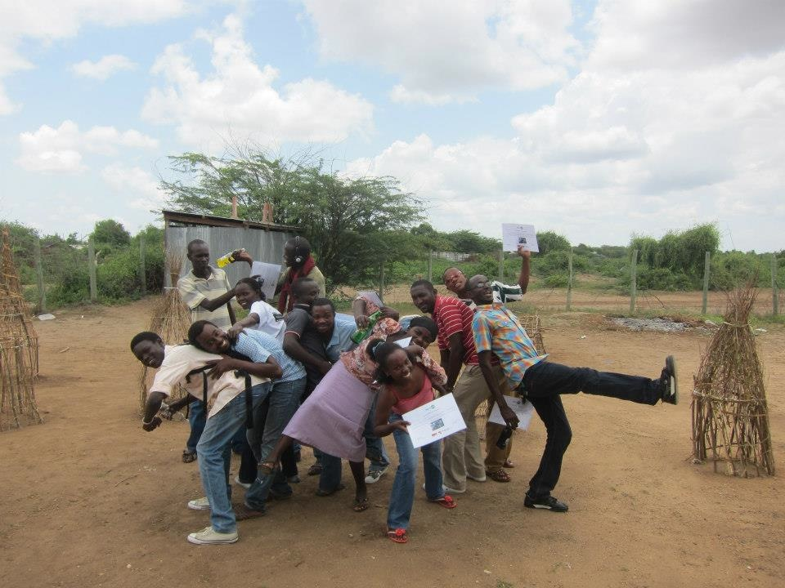
Who Lives in the refugee camp?
187,000 refugees

Slide 11
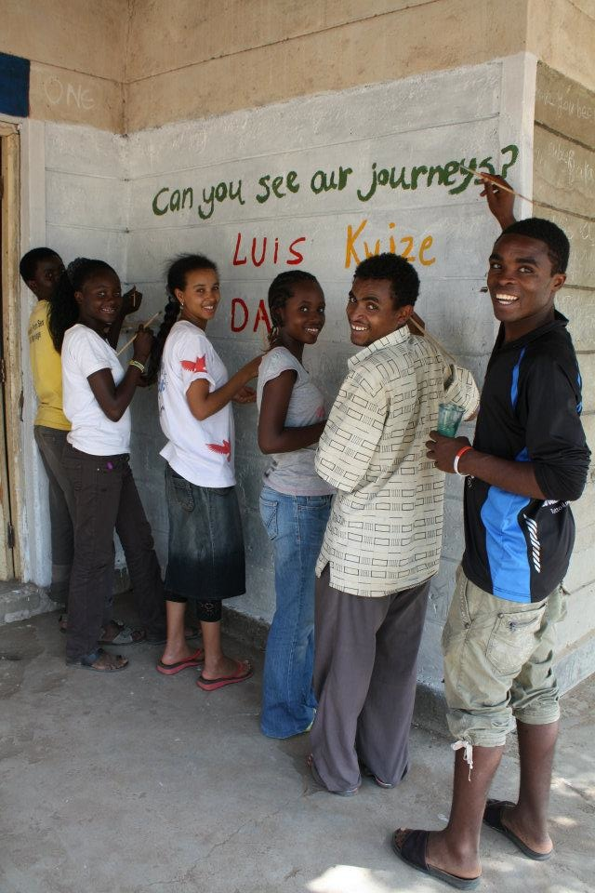
South Sudan
Sudan
Uganda
Rwanda
Burundi
Democratic Republic Congo
Ethiopia
Eritrea
Somalia
Notes:
The camp is host to people fleeing conflict from:
South Sudan, Uganda, Burundi, Rwanda, Democratic Republic of Congo, Ethiopia, Eritrea, Somalia
Total amount now in the camp 2015:

Slide 12
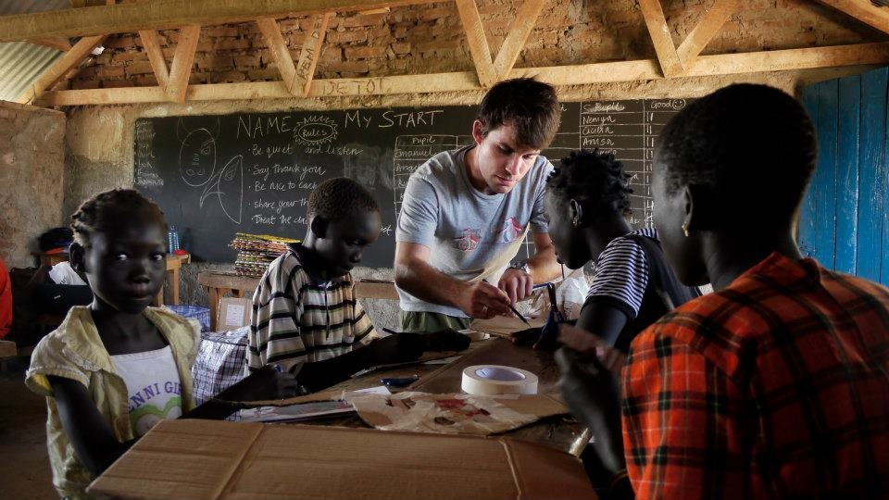
What do we do?
Kenya:
Each Summer we go to Kakuma refugee camp with a small team
artists and film makers
We work with young refugees from the ages of 6-21 years
Our groups are mixed: They are open to people from all the various
communities in the camp

Slide 13
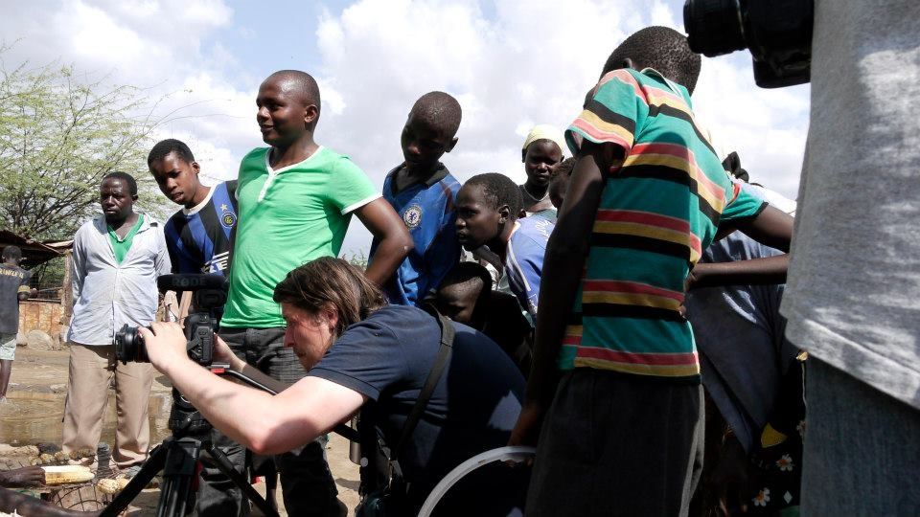
What do we do?
Kenya:
Our film workshops are run in conjunction with teenage/young adults
who are on the Film Aid course

Slide 14
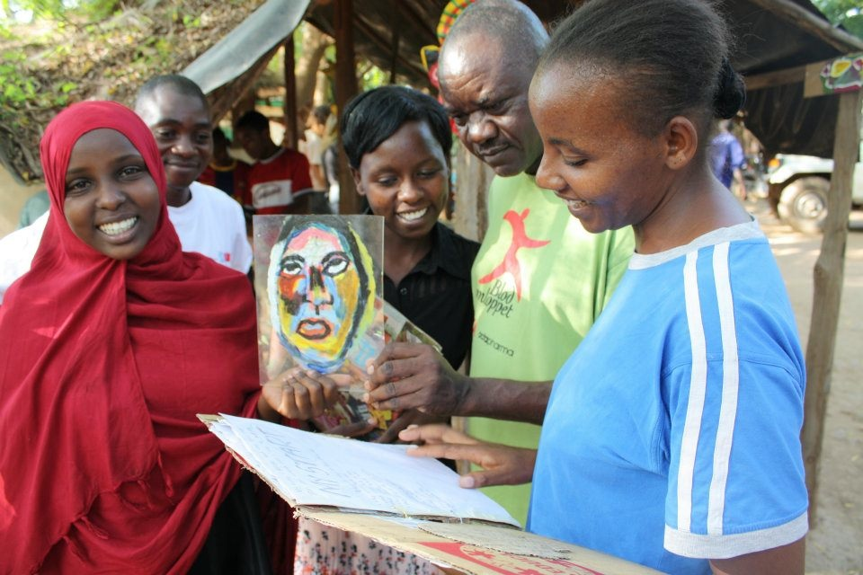
We then exhibit the work for other members of the community to view & appreciate.

Slide 15
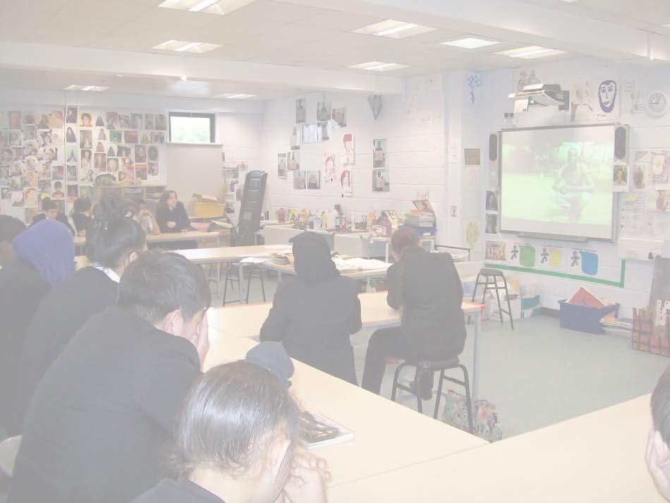
UK:
We bring the work created in the camp back to the UK and exhibit in schools here.

Slide 16
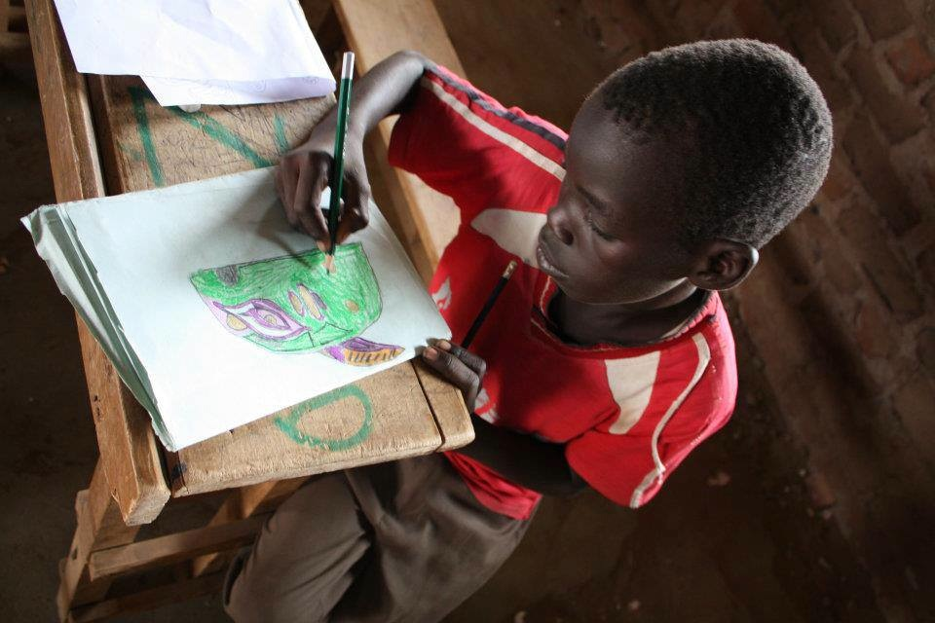
Why art in a refugee camp?
Notes:
Re-ask this question.
How has creative learning been important to them? Hint: self expression, forging identity, celebration of ‘self’, creative analysis, ability to question meaning.
Here are 2 quotes that support creative learning :
Will Gompertz, BBC Arts editor: “We live in a world of urgent problems…… we won’t resolve them with brawn; they are only obstacles we can overcome by using our brains-when we are thinking like artists not behaving like animals. And we are all artists.”
Dustin Timebrook: “The person with creative literacy is able to fins purpose and apply meaning to their world rather than having meaning handed down and purpose assigned to them”

